Slide 1
Large Scale Machine Learning
Distributed learning - Part 2

Slide 2
Previous session: Synchronous Distributed SGD
Trade-off between
Compute time
Communication time
Synchronisation time
Reducing communication cost
Exploiting sparsity
Compression
But Increasing computation
Works reasonably well in practice
Can also give a good initial solution to be fine tuned with more complex methods
Notes:
Dernier fois : comment réduire communication
Ok en pratique, mais comment faire encore mieux?

Slide 3
In Spark
// Load training data in LIBSVM format.
val data = MLUtils.loadLibSVMFile(sc, "data/mllib/sample_libsvm_data.txt")
// Split data into training (60%) and test (40%).
val splits = data.randomSplit(Array(0.6, 0.4), seed = 11L)
val training = splits(0).cache()
val test = splits(1)
// Run training algorithm to build the model
val model = new LogisticRegressionWithSGD()
.setNumClasses(10)
.run(training)
// Compute raw scores on the test set.
val predictionAndLabels = test.map { case LabeledPoint(label, features) =>
val prediction = model.predict(features)
(prediction, label)
}
Notes:
Tout cette complexité est déjà implémenté dans la spark mllib. 15 lignes de code vs 1000 ?

Slide 4
This session
Decreasing required number of iterations
Second order methods, Newton / LBFGS
ADAM
Decreasing communication cost
Tree reduce, ring reduce
Decreasing synchronization cost
Asynchronous updates!
Beyond data parallelism

Slide 5
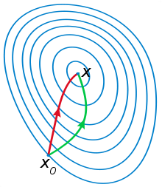
Second order optimization methods
We want to speed up our convergence in another way
Using the “curvature” information can help a lot

Slide 6
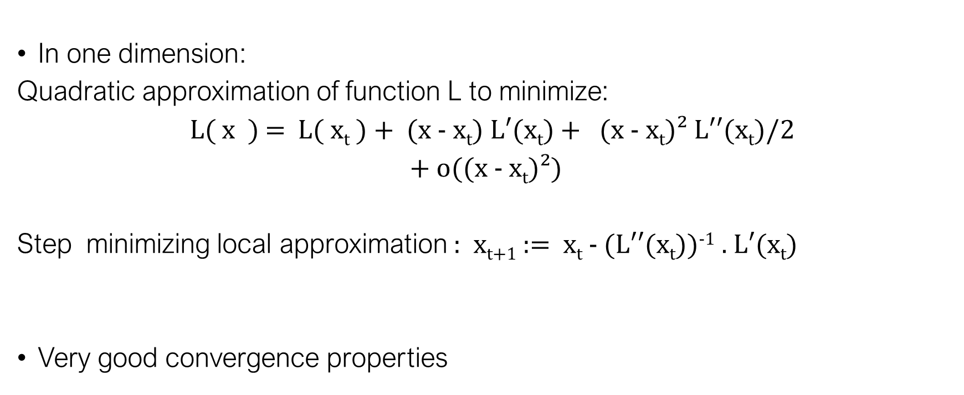
Newton’s method (1 dimension)
In one dimension:
Quadratic approximation of function L to minimize:
L( x ) = L( x_{t} ) + (x - $\text{x}\text{t}$) L$′(\text{x}\text{t}$) + (x - $\text{x}\text{t}$)² $L′′(\text{x}\text{t}$)/2
+ o((x - $\text{x}\text{t}$)²)
Step minimizing local approximation : $\text{x}\text{t}\text{+1}$ := $\text{x}\text{t}$ - $(L′′(\text{x}\text{t}$))⁻¹ . L$′(\text{x}\text{t}$)
Very good convergence properties

Slide 7
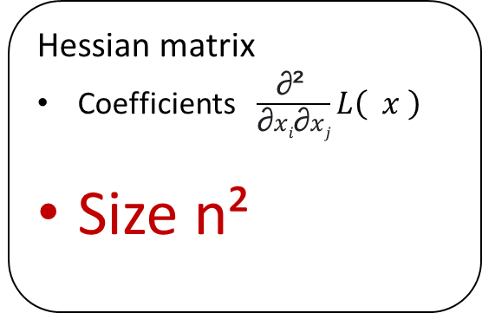
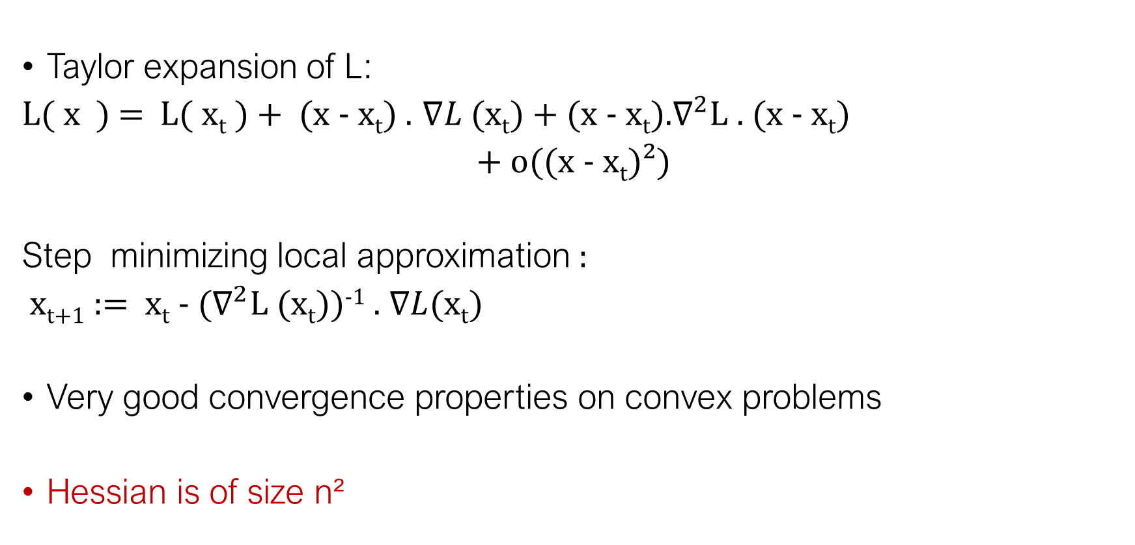
Newton’s method
Taylor expansion of L:
L( x ) = L( x_{t} ) + (x - $\text{x}\text{t}$) . $∇L$ $(\text{x}\text{t}$) + (x - $\text{x}\text{t}$).$∇^{2}$L . (x - $\text{x}\text{t}$)
+ o((x - $\text{x}\text{t}$)²)
Step minimizing local approximation :
$\text{x}\text{t}\text{+1}$ := $\text{x}\text{t}$ - $(∇^{2}\text{L} (\text{x}\text{t}$))⁻¹ . $∇L(\text{x}\text{t}$)
Very good convergence properties on convex problems
Hessian is of size n²
Hessian matrix
Coefficients$\frac{\text{∂² }}{\text{∂}xi\text{∂}xj}$ $L\left( x \right)$
Size n²

Slide 8
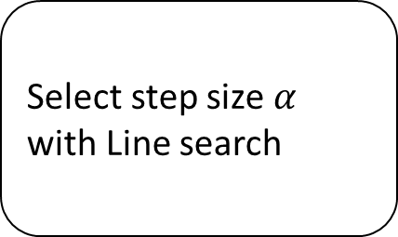
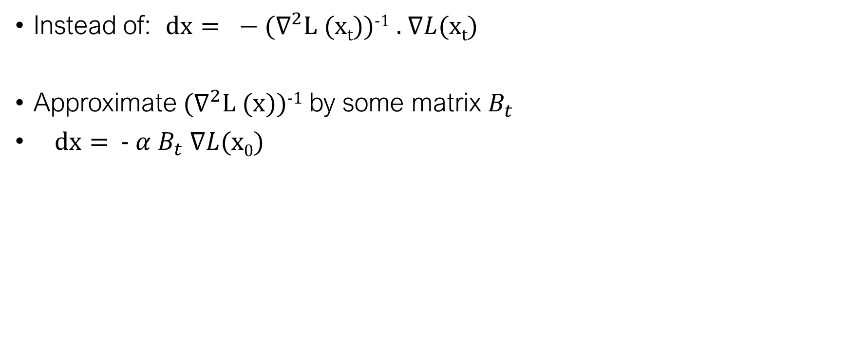
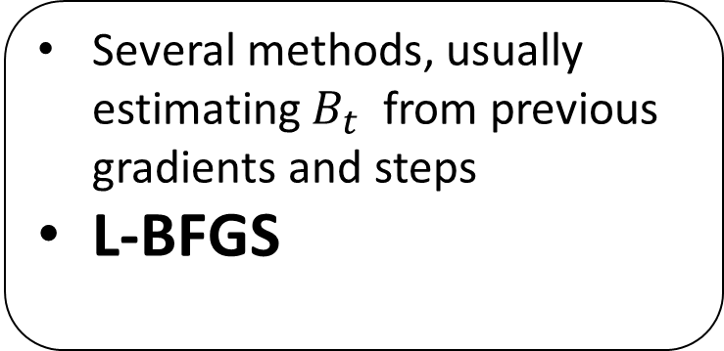
Quasi-newton methods
Instead of: $dx= −$ $(∇^{2}\text{L} (\text{x}\text{t}$))⁻¹ . $∇L(\text{x}\text{t}$)
Approximate $(∇^{2}\text{L} (\text{x}$))⁻¹ by some matrix $B_{t}$
$dx=$ - $α$ $B_{t}$ $∇L(\text{x}\text{0}$)
Several methods, usually estimating $B_{t}$ from previous gradients and steps
L-BFGS
Select step size $α$ with Line search

Slide 9
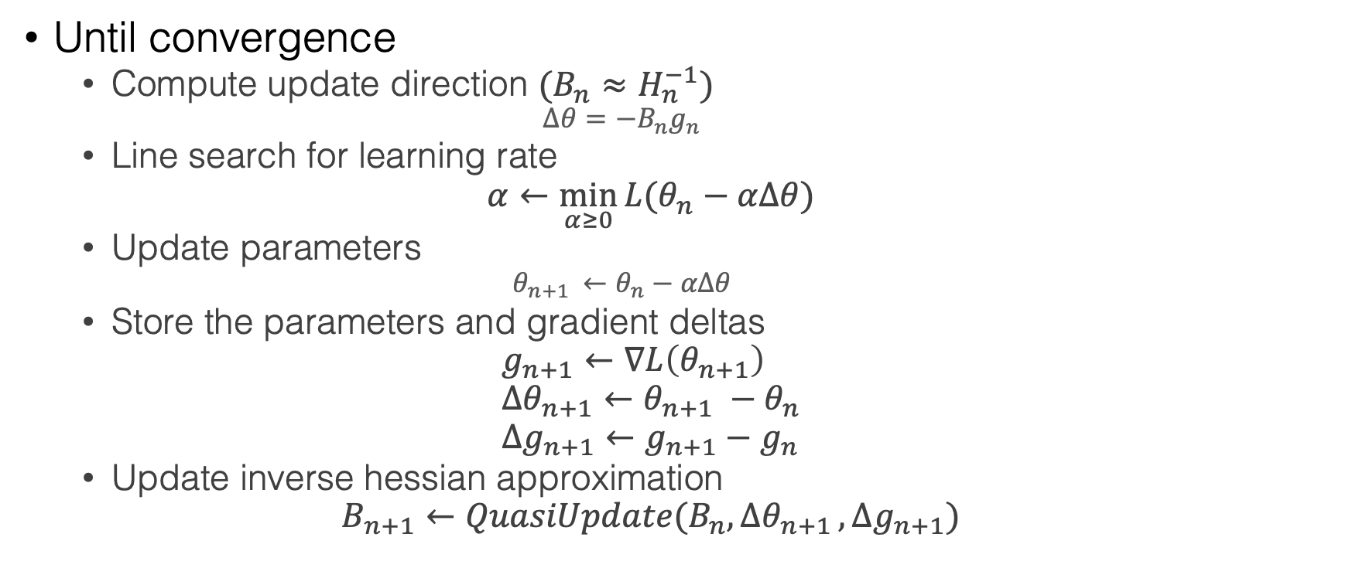
Quasi-newton methods : generic
Until convergence
Compute update direction $(B_{n}≈H_{n}^{−1}$)
$$Δθ=−B_{n}g_{n}$$
Line search for learning rate
$$α←\min_{α≥0}{L(θ_{n}−αΔθ)}$$
Update parameters
$${θ_{n+1 }←θ}_{n}−αΔθ$$
Store the parameters and gradient deltas
$$g_{n+1}←∇L\left(θ_{n+1}\right) \\ {Δθ}_{n+1}←θ_{n+1} −θ_{n} \\ {Δg}_{n+1}←g_{n+1}−g_{n}$$
Update inverse hessian approximation
$$B_{n+1}←QuasiUpdate(B_{n}{,Δθ}_{n+1},{Δg}_{n+1})$$

Slide 10
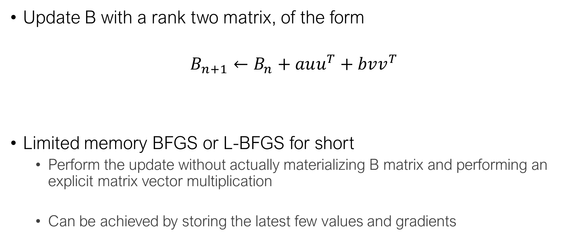
BFGS
Update B with a rank two matrix, of the form
$$B_{n+1}←B_{n}+auu^{T}+bvv^{T}$$
Limited memory BFGS or L-BFGS for short
Perform the update without actually materializing B matrix and performing an explicit matrix vector multiplication
Can be achieved by storing the latest few values and gradients

Slide 11
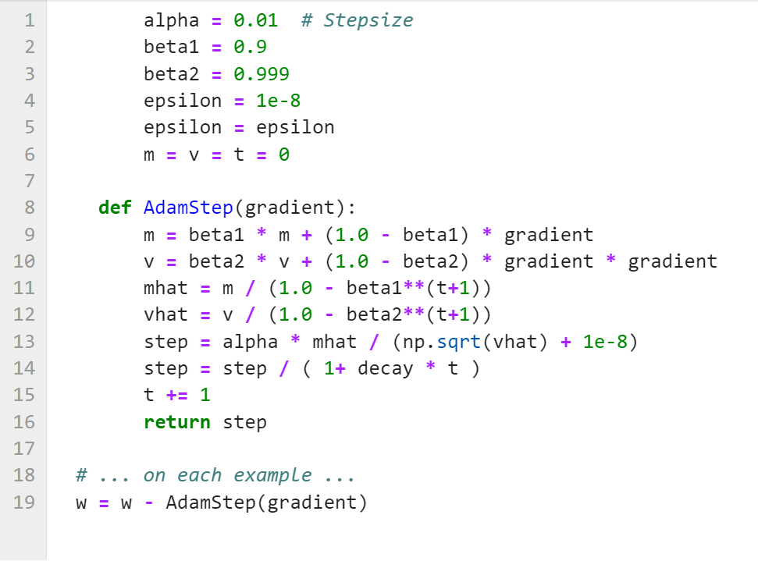
ADAM

Slide 12
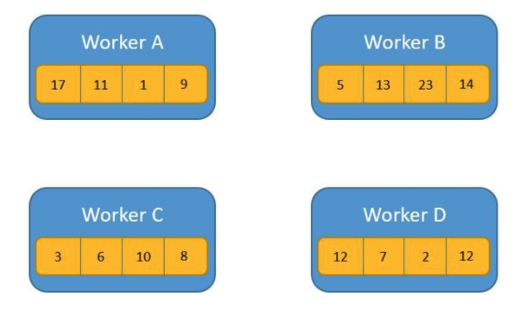
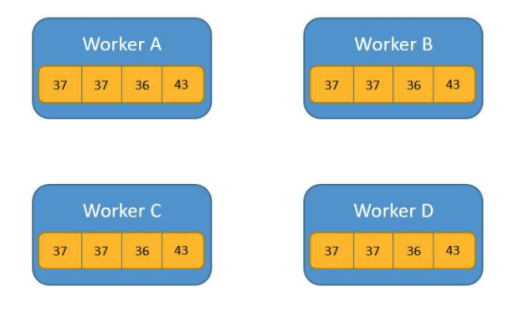
AllReduce
Local gradients on the workers
We need to :
Sum all local gradients
Send the sum to all workers
https://towardsdatascience.com/visual-intuition-on-ring-allreduce-for-distributed-deep-learning-d1f34b4911da
Notes:
On sort du monde du parameter server
AllReduce
Average all the values in all the computation nodes and send the averages value to all the nodes
Example: averaging gradients !

Slide 13
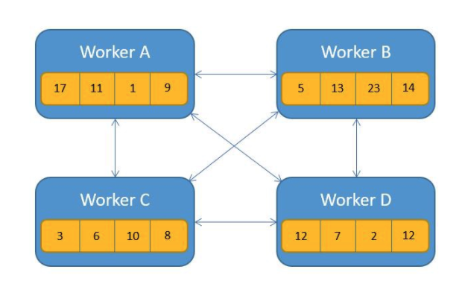
AllReduce: all to all communication
Notes:
implémentation super naïve
Saturate messaging network
Qui peut m’expliquer comment spark fonctionne par défaut pour les aggrégations?

Slide 14
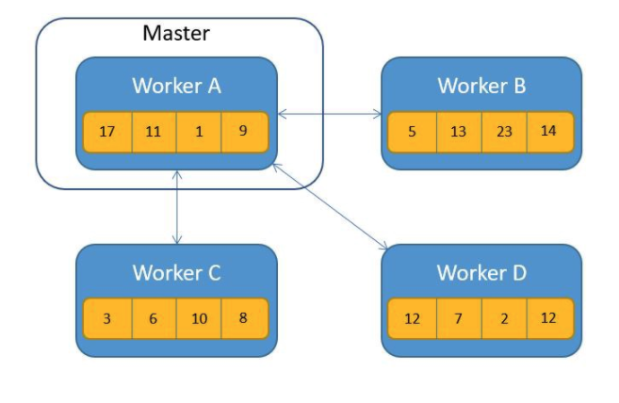
AllReduce: Reduce then Broadcast
Notes:
Naive: Reduce and then Broadcast like the first Spark snippet
Driver becomes the bottleneck

Slide 15
AllReduce
Notes:
Implementation
Optimized: do both reduce and communicate at the same time
Plein de gens ont passé du temps sur ce probleme spécifique : communiquer et aggréger
Tree aggregate spark
Définir schéma de commiunication nb fleche vs depth
Tree : attention, gradients de moins en moins sparse
Tree all reduce is the same as reduce and then broadcast: 5 comm steps
Butterfly all reduce: 3 comm steps

Slide 16
Ring AllReduce

Slide 17
Ring AllReduce

Slide 18
Ring AllReduce

Slide 19
Ring AllReduce

Slide 20



Parameter server to avoid synchronization
One server with “latest” parameters
No sync between workers !
Parameters
Gradients
Workers iterate:
Read a minibatch of data
Pull latest parameter
Compute the gradient
Send parameters updates
Notes:
Avoid synchronization cost!
Fault tolerance
Can add / remove workers during training
No sync is Ok if … the model is sparse (low probability that two workers update the same parameters), or if doing small enough steps.

Slide 21
Bottleneck: Bandwidth on the master?
Split the parameters on several servers!
Parameters
Gradients

Slide 22
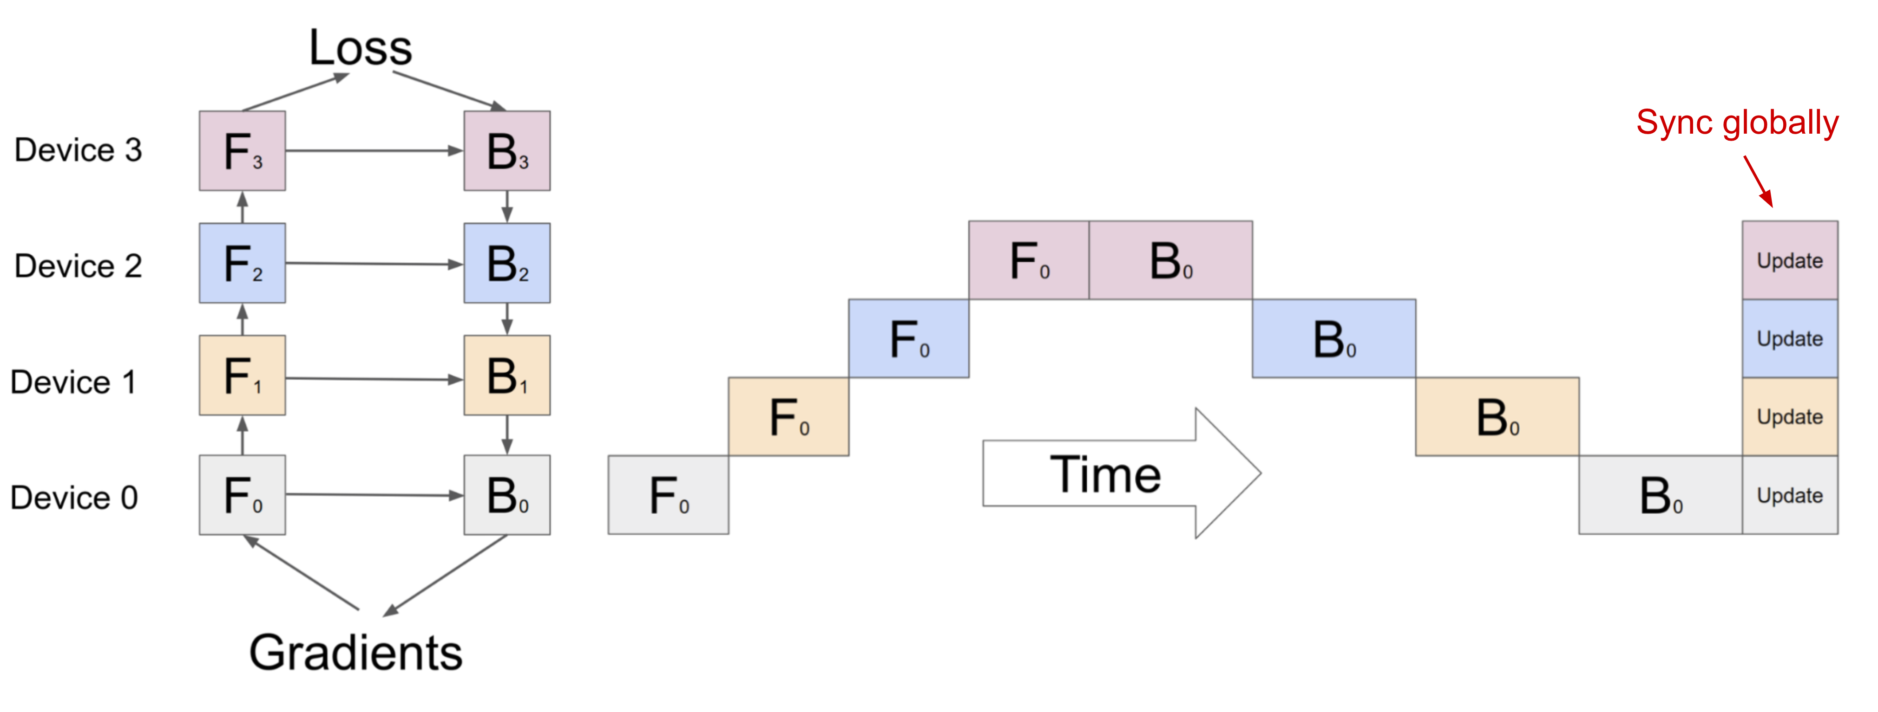
Beyond data parallelism
Very large models: too big to fit on a single worker
=> Requires to split a model among several workers, eg one layer / worker

Slide 23
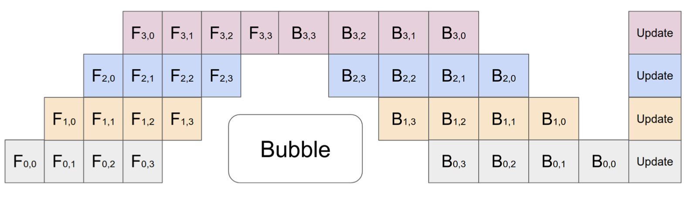
Pipeline parallelism model parallelism + data parallelism
GPipe https://arxiv.org/abs/1811.06965
See also https://lilianweng.github.io/posts/2021-09-25-train-large/

Slide 24
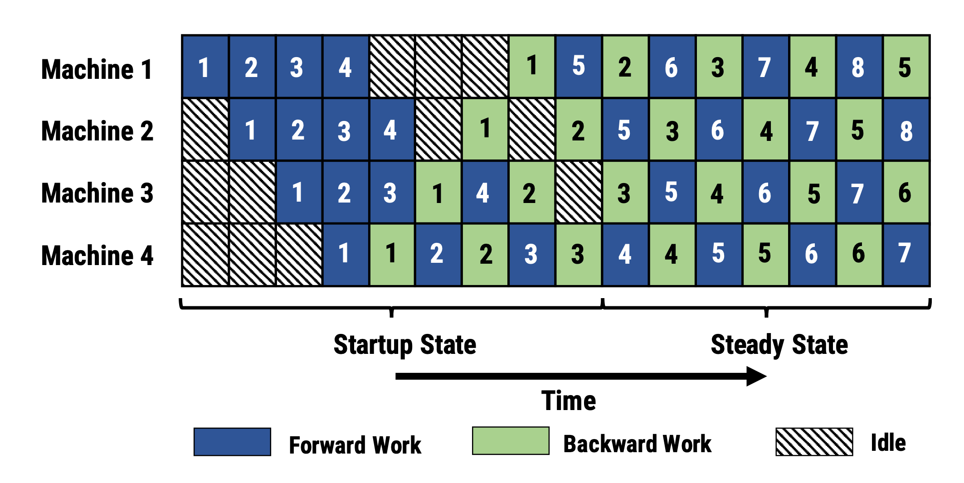
Asynchonous pipeline parallelism
Pipedream https://cs.stanford.edu/~matei/papers/2019/sosp_pipedream.pdf
Complication:
Ensuring the same version of the weights are used in forward and backward passes

Slide 25
Tensor parrallelism
When a single layer is too large ( eg large input embedding layer)
Typically, decomposing a matrix multiplication by block
= *
A₁
A₂
Y
X₁
X₂
compute each block on different workers
requires a synchronization to gather the blocks

Slide 26
Conclusion
Distributed Machine Learning is about trade-offs
Communication VS computation cost
For simple models (like Logistic Regression), a synchronous approach works well
Exploit sparsity
Use more complex optimization schemes
There are several ways to distribute and aggregate computation
Centralized synchronous or asynchronous model, AllReduce …
Notes:
Pas de formule magique pour tous les problèmes,
Compréhension fine de la tache
Important de comprendre les spécificités du problème en cours, les simplifications possibles pour trouver la meilleure solution.

